Slide 1

Open Compute Project
Open Chiplet Ecosystems and Economies for Disaggregated Systems
4th International Workshop on RESource DISaggregation in High-Performance Computing
November 17, 2024
Cliff Grossner, Ph.D., Chief Innovation Officer, OCP

Slide 2
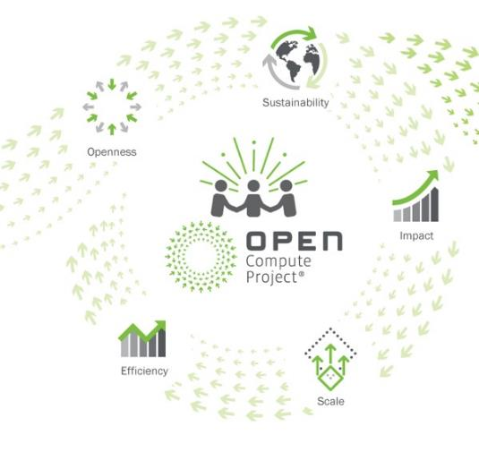
Meeting the Market and Shaping the Future
COMMUNITY
Hyperscale Centric
OPEN INNOVATION
Hyperscale-proven designs
Trusted IP model
Specs, best practices
Rapid technology adoption
Multi-vendor ecosystems
Future technologies
Notes:
Open Compute Project has a mission that has evolved since its inception 12 years ago,
but has remained constant over the last three years:
To meet the market’s requirements and shape the future
To achieve this mission,
the OCP Foundation fosters a collaborative community
that comes together to solve shared problems
to the benefit of the entire community.
At the center of the community
are the hyperscale data center operators
Who often encounter the difficult at scale problems
needing innovations before others in the community
They are joined by other organizations
from many corners of the data center industry including
IT vendors, DCF Vendors, Facilities providers, Telecom Providers
Work done by the Community results in
open hardware specifications, blueprints
best practice documents, and white papers
Then leveraged by OCP Vendor Members
Delivering products and solutions
Showcased at the OCP Market Place
The Community ensures that all outputs follow the 5 OCP Tenents
Open, Sustainable, are Efficient and Impactful, and apply at scale

Slide 3




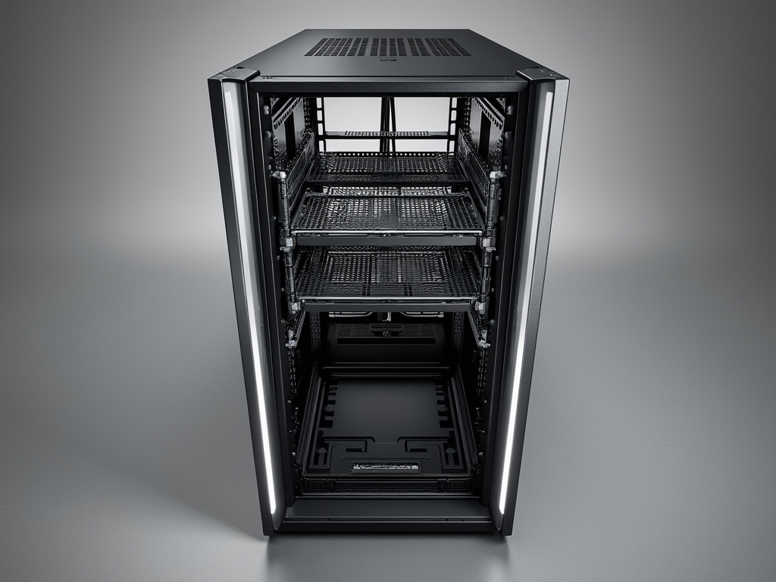

Impacting Data Center IT and Facilities
From hyperscale to distributed edge data center technologies
From silicon to systems to physical facilities
Notes:
Scope of the OCP ranges from large centralized data centers to edge DC-like (server-based) sites
Scope of technology spans the spectrum of silicon to systems to physical site facilities

Slide 4















































Diverse Membership
Cloud
Co-location
Enterprise
System Integrators
DC Equipment
IT Equipment
Component
Startups

Slide 5





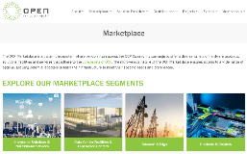



















OCP: A Collaborative Community Effort
INCUBATOR
COMMUNITY PROJECTS
NEW INITIATIVES
EMERGING MARKETS
TECHNOLOGY
OCP MARKETPLACE
Open Systems for AI
Networking
Server
Telco
Storage
Rack & power
Evenstar OpenRAN
DC IT Infrastructure
DC Physical Infrastructure
Test & Validation
RECOGNITION PROGRAMS
Time
Appliances
Cooling
Environments
Security I Facilities
Systems Management
MARKETS
Open
Systems
Firmware
Data Center
Facility
Product
Hardware
Management
Sustainability
Security
Chiplets
Photonics

Slide 6




Future Technologies at OCP
FTS
FTI
SYMPOSIUM
INITIATIVE
Events co-located with OCP Summits
Mix of academia, startups and research orgs
3-5+ years to mature into projects / products
2-page papers, posters and select talks
Examples:
Quantum hybrid DC and communications
Next-gen 2-phase cold-plate cooling for AI
3D optics for interconnect at scale
Natural hydrogen and SMRs for data centers
FTI pre-IP problem definition workstreams
2-5 years to mature into projects / products
Mix of startups, academics, and vendors
Goal to transition to (sub)project workstreams
Examples:
AI HW/SW Co-design
Short-reach optical interconnect
Data-centric computing

Slide 7

Open Chiplet Economy from Cloud to Edge
Notes:
The OCP Community has been looking at Chiplets for the last 5 years to address key industry challenges and have some information to share with you.

Slide 8
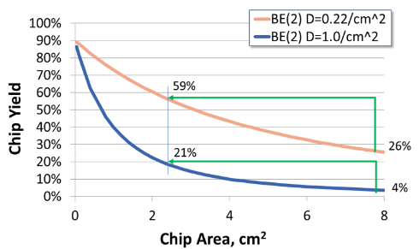
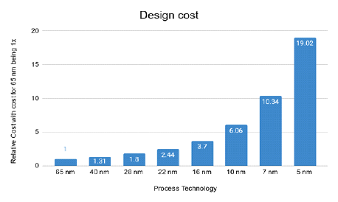
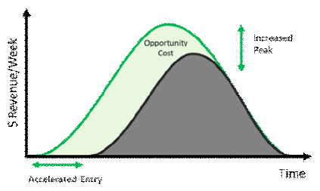
Major Benefits of Chiplets, but there are Challenges
Yield Advantage
Smaller die → higher yield
Can offset higher package & test cost for systems
Design Cost Advantage
Newer processes are more expensive to design
Multiple vendors & designs choices
Time to Market Adv.
Chiplet reuse speeds TTM
Improves returns by:
Higher market share
Longer product life-cycle
Higher profit margin
Notes:
There are many potential advantages to using Chiplets
Chiplets can help to overcome the yield challenges with newer process nodes as transistor density continues to go up by having a smaller die size to reduce complexity
Once a Chiplet is designed and tested on a particular processes node, it can remain on that technology for several product generations, allowing re-use and reducing risk and re-design effort
Re-use can also have the benefit of redicing time to market for each successive product generation, helping to maximize revenue over the product lifetime

Slide 9
Chiplet Market Projected at $100B+ by 2033
$164B
End Systems
Servers, PCs, Mobile, Automobiles
Components:
CPUs, GPUs, APUs, FPGAs, IP
AI ASICs co-processors, HBMs, IO
Chiplets
Electronic Equipment
Manufacturing
Materials, Packaging, Testing, IP
Units
$Rev
$140B
$9B (2)
404M
325M
$101B
235M
Sources:
Chiplet Market Update | Chiplet Summit Yole Intelligence; https://www.yolegroup.com/ , 2022
“Chiplet Market” Semi and Electronics, Market.us, Aug 2024, https://market.us/report/chiplets-market/#overview
2024
2025
2026
Global Semi-Conductor Market
Notes:
It is always important to understand what is the scope of the market impact, and no better way to measure this than in dollars
Consulting lead analyst firms Yole and Market.US we learn that by 2026 the market for Chiplets is expected to hit $9B out of $164B for the Semi-conductor market
Looking to 2033, the chiplet market is expected to top $100B

Slide 10












Today’s Reality: Chiplets Solutions From Single Vendor + Partner
HBM
Mediatek
CPUs, GPUs, FPGAs
CPUs, GPUs, FPGAs
Graviton
Dreambig
Switches & Custom ASICS
M1 Ultra
LG Electronics
Notes:
The state of the industry today is that the Chiplet Market is closed with only a few large companies participate in mostly in-house and proprietary
Single vendor chiplet solutions are available from many Silicon vendors – Big 3, hyperscale, consumer, startups
Some of these companies work with partners – example Nvidia with Mediatek, ..
They have recognized the challenges of monolithic dies and broken up their monolithic dies into chiplets.
Can use proprietary solution; and not worry about standards
They have a good grasp of the market opportunity, risk-rewards, and accountability is solely owned
The challenge is how can we unlock innovation and extended Chiplet technology to broader open eco-system accelerating Chiplet adoption

Slide 11
Chiplet Adoption: Broad Ecosystem Solutions Are Next……
1
2
3
Single Vendor Solution
Multi-Vendor Solution
Broad Ecosystem Solutions
I/O Hub
(7 nm)
More IO
DSP (16 nm)
DDR Mem
AI Accel
(5nm)
I/O Hub
(7 nm)
CPU (4nm)
DDR Mem
I/O Hub
(7 nm)
D2D
D2D
D2D
D2D
D2D
DDR Mem
D2D
I/O Hub (12 nm)
CPU (5nm)
AI Accel
(5nm)
CPU (4nm)
AI Accel
(5nm)
DDR Mem
D2D
D2D
DDR Mem
SerDes
D2D
D2D
D2D
D2D
SerDes
D2D
D2D
D2D
D2D
SerDes
CPU (5nm)
GPU (5nm)
I/O Hub
(7 nm)
SerDes
DDR Mem
Radio (5nm)
D2D
D2D
Radio (5nm)
D2D
D2D
D2D
I/O Hub (7 nm)
D2D
DDR Mem
D2D
D2D
DDR Mem
SerDes
SerDes
What: All components controlled & optimized by a single company
How: can use proprietary solution; no standards needed
What: SoC products target specific markets/families, specific parts
How: some open standards, rest agreed upon by partners
What: “Any” chiplet can plug in “anywhere”
How: Many aspects standardized; minimal prior coordination needed
Notes:
To understand how to enable a move to Broad Chiplet Ecosystem Solutions, we need to take a quick look at the Journey of the Current organizations using chiplets
1) The early Chiplet based SOCs were designed in-house by a single silicon vendor where all components and design decisions were done within a single company.
While there are interactions needed between different teams designing the chiplets, then the assembly and test teams and final packaging and ship activities,
These interactions were within one company and they were able to choose ad hoc methods to determine design tradeoffs and had no need for any standardizations
2) As the market evolved with more complex designs and chiplets being designed and manufactured by a pre-determined set of partners, some open standards were needed but mostly proprietary methods were agreed and shared among the partners under NDA. The market for Chiplets is still controlled by one company, or a select small set of partner companies
What will it take to get to the open ecosystem we desire!?

Slide 12
…. Open Chiplet Economy for Diversity and Innovation
To meet huge diversity in requirements we need
A core set of application specific standards
A low barrier to entry for innovation
Freely customizable for applications
Build and let the market use as it sees fit
Packaging Technology
Interconnect Technology
Chiplet IP/ SOC Architectures
Notes:
In our experience, for a new ecosystem to form, it takes a collaborative effort to develop a new set of standards.
For Chiplets, this is also the case, but in addition barriers that keep smaller and innovative companies from participating also need to be overcome
In the longer term, we need the capacity to have drop in, or plug and play ecosystems for Chiplets for different market segments
This will allow a marketplace for Chiplets where designers select the Chiplets they need and use as they see fit

Slide 13
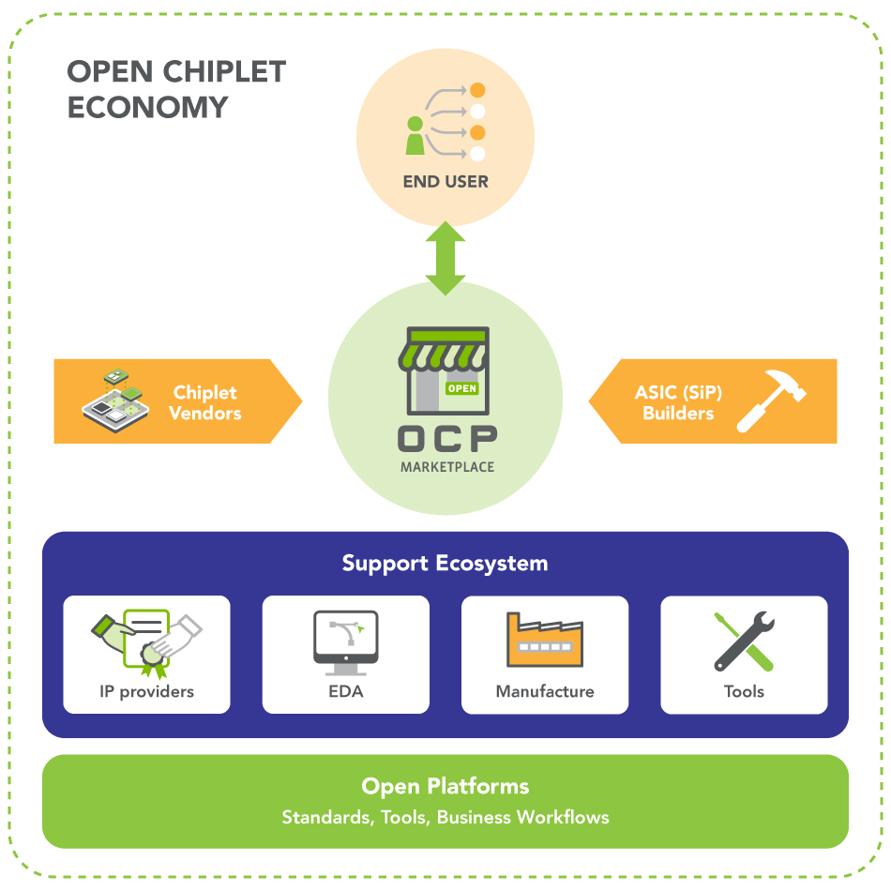
OCP Fostering an Open Chiplet Economy

Slide 14
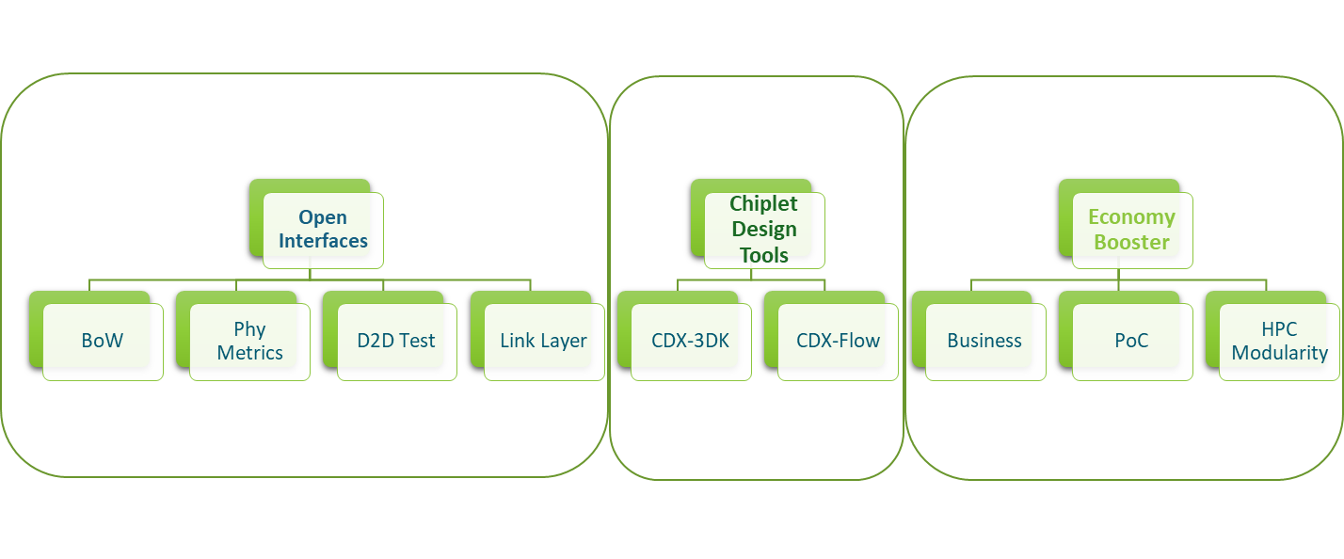
Open Chiplet Economy Project
Economy Booster

Slide 15
OCP Open Interfaces

Slide 16
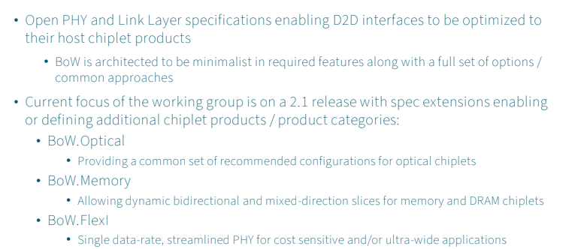
BoW 2.1 Targets 3 New Use Cases

Slide 17
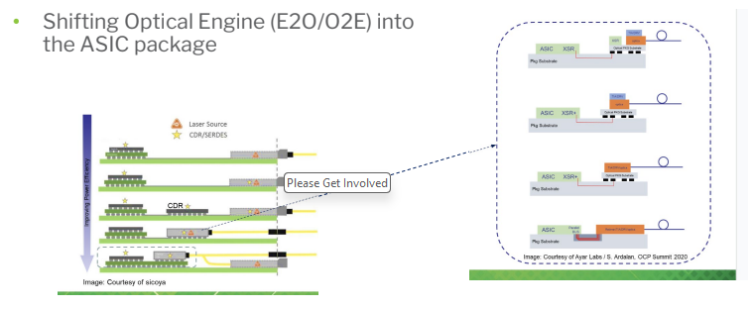
BoW 2.1: Optical Package Options

Slide 18
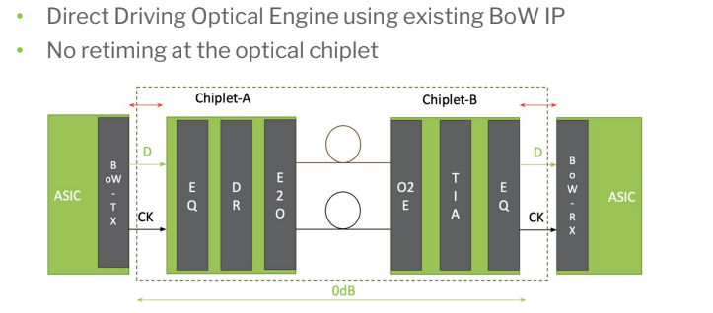
BoW 2.1 Optical Direct Drive Chiplet

Slide 19
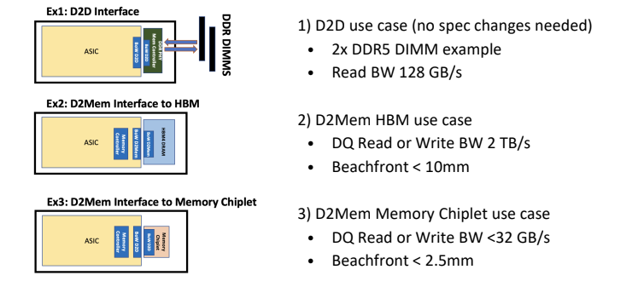
BoW 2.1 Memory Interconnect

Slide 20
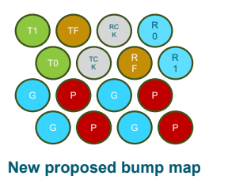
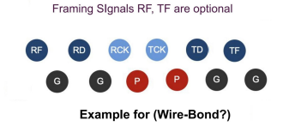
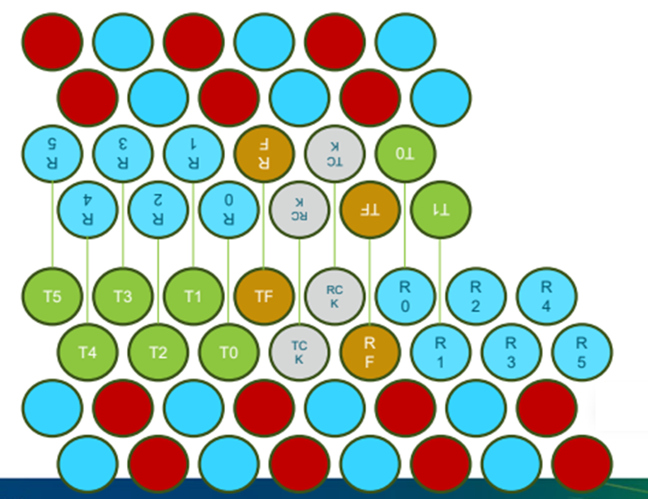
BoW 2.1 FlexI
Market needing low-cost and medium bandwidth connection
IoT, and Industrial
Markets needing ultra-wide interfaces for HPC and advanced packaging
High bump density for 2.5D and 3D

Slide 21
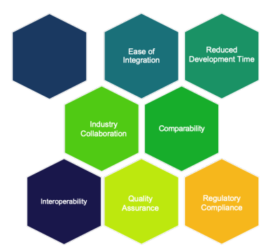
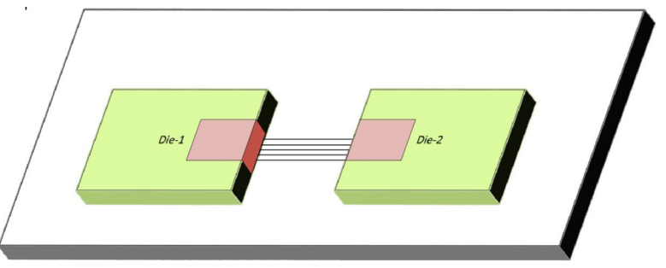
Standards for Comparing Die to Die Interfaces

Slide 22
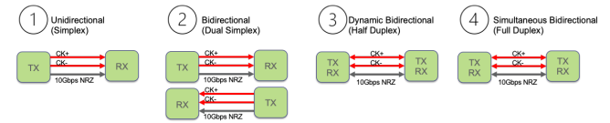
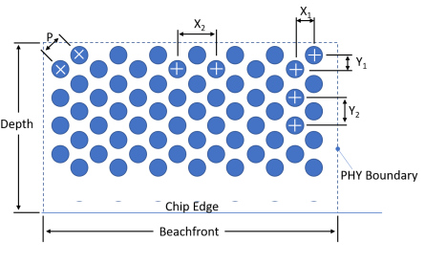
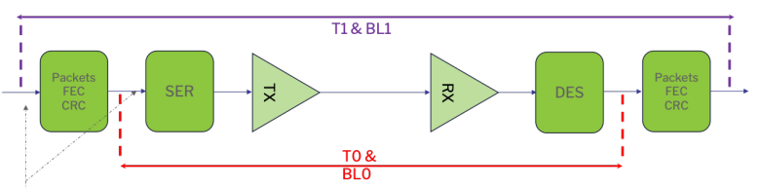
Leveling the Playing Field
Interface Qualitative Attributes
On Die Parameters
(Bump, Area, Latency, BER)
Figures of Merit
(Power Efficiency, PWR Bandwidth Density, etc.)
Calculating Data Rate
Phy Pitch and Size
Latency and BER

Slide 23
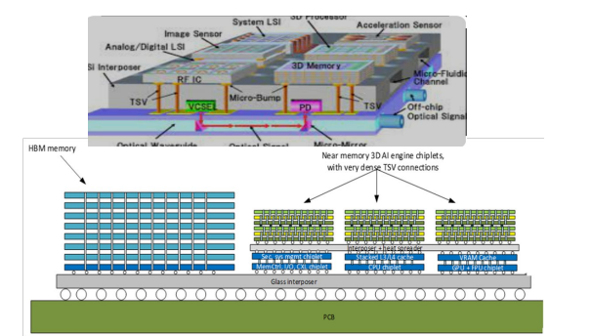
SiP Test and Validation Challenges
Design for Test (Multi-vendor)
Structural defect coverage
Standards interoperability
Known good die
Test Architecture
Hierarchical, including Repair
Individual Chiplet Test Data Availability
Functional Test
System Level Test
Use Case Scenarios Described

Slide 24
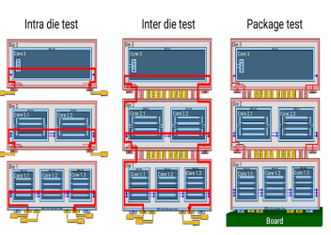
Design For Test Strategies
Structured Techniques
Scan and Automatic Test Pattern Generation
Memory and Logic Built in Self-Test
Hierarchical Test
Standards
IEEE 1149.x Boundary Scan
IEEE 1500 Embedded Cores
IEEE 1687 for Embedded Instructions
IEEE 1838 Test Architecture

Slide 25
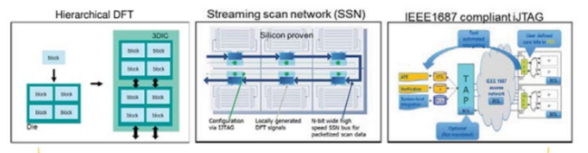
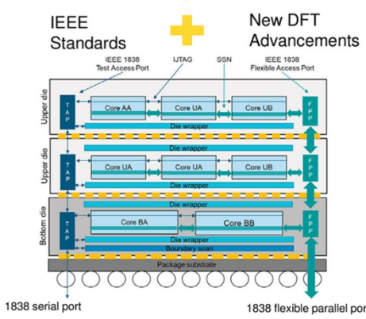
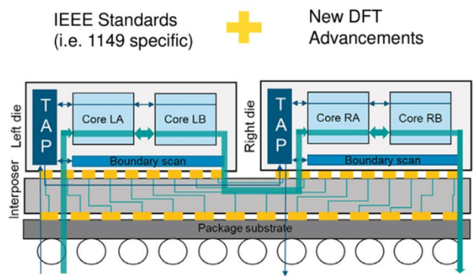
Design for Test of 2.5D and 3D Packaging

Slide 26
Chiplet Design Tools

Slide 27
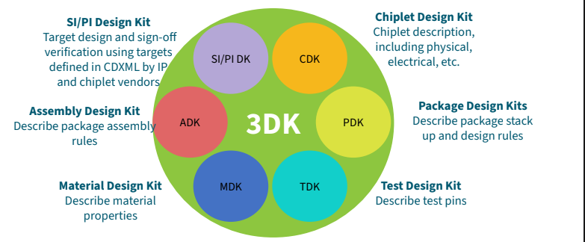
Automating 3D-IC Design with CDXML

Slide 28
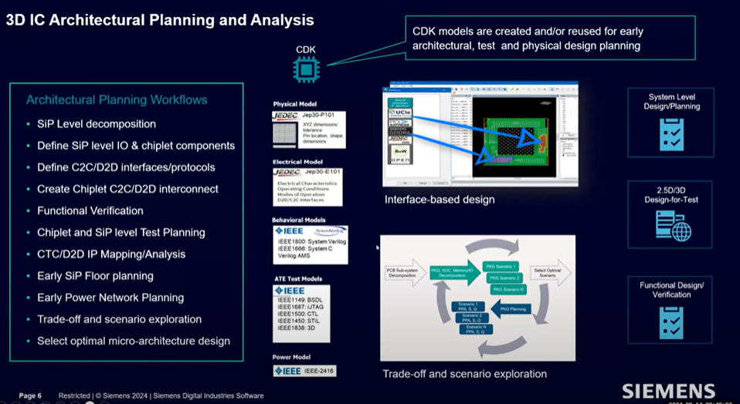
3D IC Architectural Planning and Analysis

Slide 29
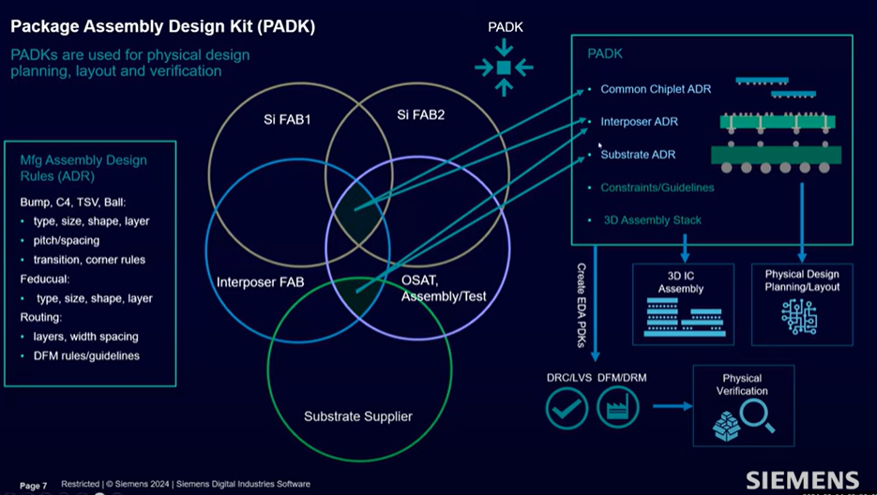
Package Assembly Design Kit

Slide 30
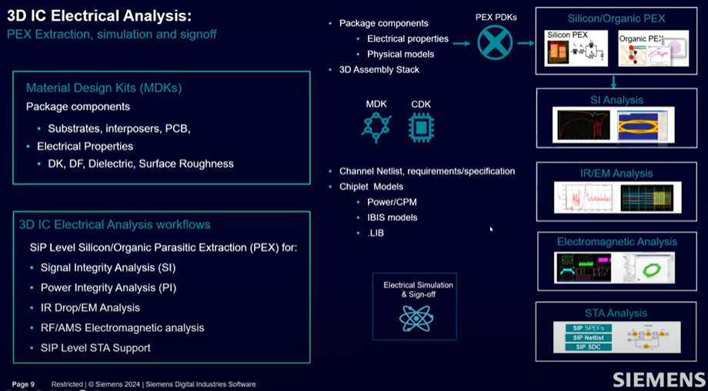
3D IC Electrical Analysis

Slide 31
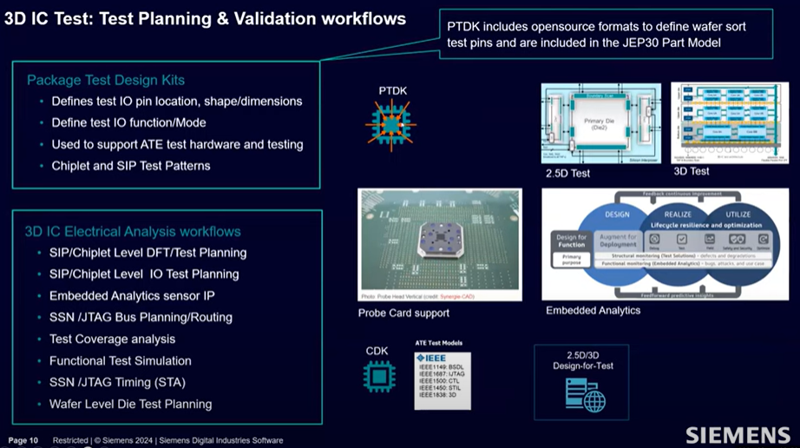
3D IC Test Planning & Validation Workflows

Slide 32
Economy Booster

Slide 33
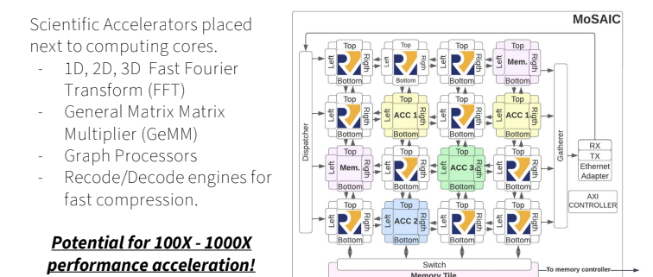
Accelerating HPC and AI

Slide 34
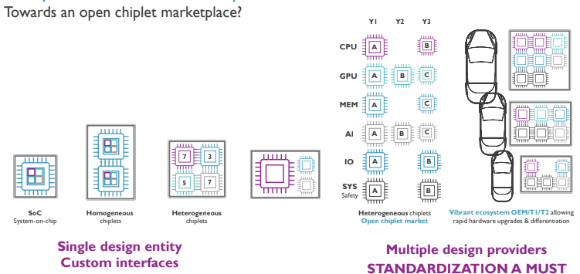
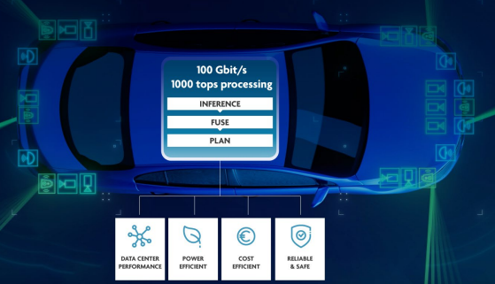
Automotive Use Case for Chiplets

Slide 35
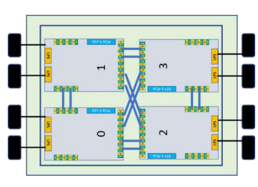
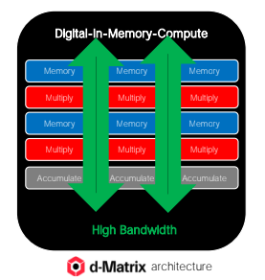
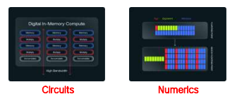
Chiplet Based Solution for Generative Inference
New AI
Computing Paradigm
In-Memory Compute
Block Float Data Types

Slide 36
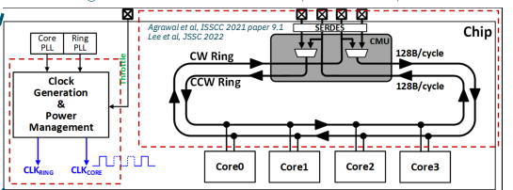
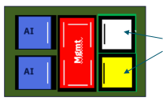
IBM SpyreTM AI Accelerator
Third Party Chiplets
IBM Artificial Intelligence Unit
IBM Chiplet Plan

Slide 37
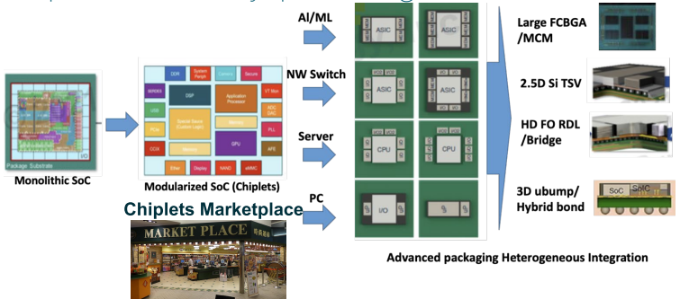
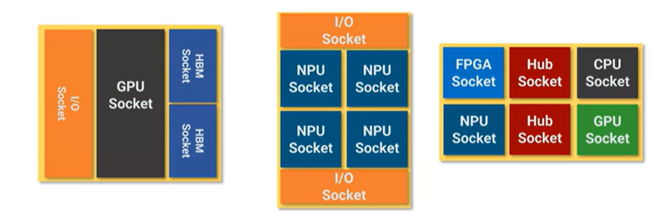
Specialized Use Cases Need Standardized Form Factors

Slide 38

























Open Chiplet Economy a Growing Ecosystem…
Notes:
At the OCP, we have a large and growing community already represented at the OCP Open Chiplet Economy Marketplace

Slide 39
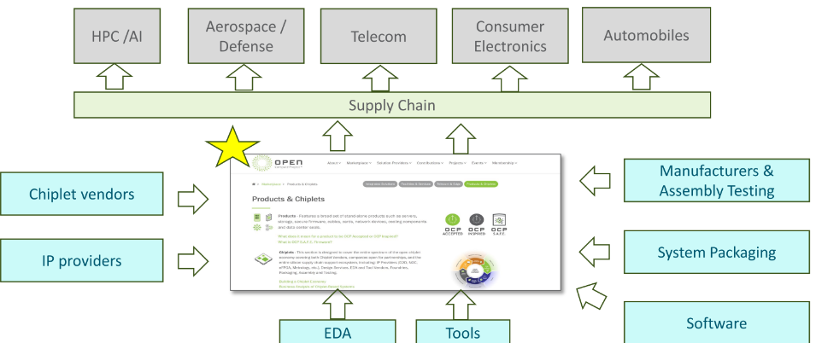
Moving the Market with OCP Open Chiplet Economy Marketplace
Notes:
The OCP Open Chiplet Economy Marketplace Opens its Doors at the OCP Web site
Silicon chip builders can now find all they need to deliver Chiplet-based products
1) Standalone Chiplets, design and manufacturing services,
2) Chiplet-aware EDA tools, and reference material
Provides open environment where designers drop third-party sourced Chiplets into their designs
Delivering on the Promise of An Open Chiplet Economy for all
OCP Community standardizations, tools, best practices for new technical and business workflows will be pivotal in advancing the widespread use of Chiplets
OCP believes the time is right for the launching of a ‘drop-in’ Chiplet marketplace as the first wave of standardization is complete.
Since its inception, the OCP Open Chiplet Economy Project (formerly ODSA) has led in advancing the use of Chiplets
Bringing together a diverse community of contributors: semiconductor manufacturers, system integrators, and technology providers,

Slide 40
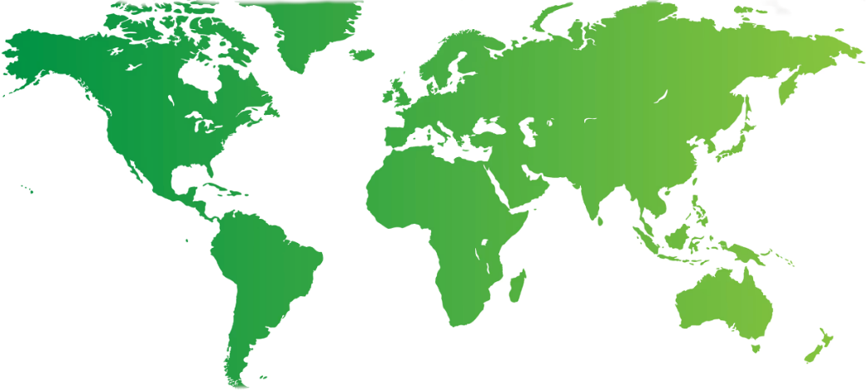

OCP Major Events Showcasing Open Chiplet Econmy
Regional Events:
China Day
Q3-25
Beijing, PRC
Global Summit
Oct 13-16
San Jose, CA
South Korea
Q3-25
Seoul, KR
Taiwan
Q2-25 Taipei, TW
EMEA Regional Summit
April 29-30
Dublin, IR
Notes:
2024 OCP Global Summit: October 15 – 17 – San Jose, CA
2025 OCP EMEA Summit: April 29 – 30 – Dublin, Ireland
2025 OCP China Day: Beijing, PRC
2025 OCP APAC Summit: TBD
Maybe Taiwan

Slide 41


Please Get Involved
Join
Project Mailing Lists
Project Calls
Open Systems for AI Initiative
Drive
Project Focus
Thought Leadership
Run
Projects and Workstreams
Technical Steering Committee
Contribute
Effort
Specifications
Products and Facilities
Attend
OCP Summits
OCP Panels
Engineering Workshops
OCP Webinars
3rd Party Events

Slide 42
Thank You

